Slide 1
ClimbCode
Notes:
Welcome to ClimbCode’s exposition. Here we’ll see the results of the development’s second sprint of this project.

Slide 2

Our Path Today
Idea
Technologies & Work
Things Done
Pilot Plan’s Results
Status
2
Notes:
This is the path we’re going to follow during the presentation. First we’ll introduce the idea behind ClimbCode, next we’ll see the technologies we’re using to develop ClimbCode, after that, we’ll talk about the things we’ve done, the ones we’re doing and the ones we’re going to do. Finally, we’ll see some conclusions for our project.

Slide 3
Idea
Notes:
We’ll start seeing which idea lies behind ClimbCode. But first, let me introduce two facts:

Slide 4

4
Notes:
As JFK said: ”Let us think of education as the means of developing our greatest abilities”. I’m sure we all think that is by the education how we improve ourselves and become better people each day that passes, right?

Slide 5

5
Notes:
Then let’s see the other concept. As Steve Jobs said: ”Computers themselves, and software yet to be developed, will revolutionize the way we learn”. To prove this, we only have to see systems like our blackboard system or the digital blackboards used in schools, thanks to the software and its development.

Slide 6

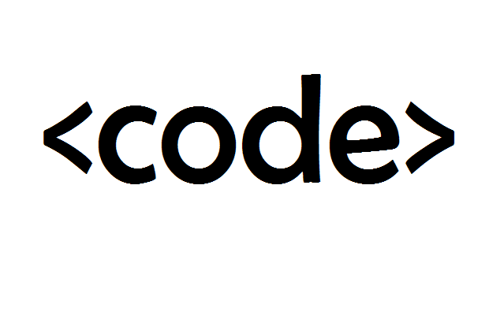
Idea
+
=
ClimbCode
6
Notes:
Then what would happen if we combined those two apparently independent concepts: Education and Software? The answer to this is ClimbCode, our web platform, which acts as a supporting tool for teaching with the help of programming and software.

Slide 7


Idea
Interactive
7
Notes:
How do we grant this support? Simple, by interactive exercises, a better version of the original paper exercises made by independent programmers. Those exercises are bought by schools in order to increase their content catalog they have for supporting their subjects.

Slide 8


Learn Programming?
8
Notes:
But then, is it imperative to know programming to use our platform as a school? That is a question whose answer can be a little controversial. We’ll see its answer once we talk about the feedback we’ve got during our pilot plan.

Slide 9
Technologies & Work
Notes:
Ahora hablaremos de la metodología de trabajo que estamos siguiendo para desarrollar el proyecto, así como la tecnología que estamos utilizando.

Slide 10

Work Methodology
SCRUM
10
Notes:
Para desarrollar nuestro proyecto hemos adaptado a nuestra forma de trabajo la metodología SCRUM mencionada en la asignatura, haciendo reuniones semanales para ver el desarrollo del proyecto, repartir tareas y discutir elementos de desarrollo y gestión, siempre basándonos en los sprints, el product backlog y el sprint backlog propio de SCRUM.

Slide 11




Technologies
Main:
11
Notes:
For the main development of our project, we’re using PostgreSQL, Django and Python for our back-end, and Bootstrap for our front-end.

Slide 12


Technologies
Deployment:
12
Notes:
For the deployment of the project, we’ve used mainly Digital Ocean, but at first we approached to Heroku before we discovered that it wasn’t as good as Digital Ocean in response times and availability. Despite that, we still have a version deployed in heroku in case that the Digital Ocean one doesn’t work.

Slide 13




Technologies
Interactive Exercises:
13
Notes:
For the interactive exercises’ system, we’re using JavaScript, with Ace for a little help with the syntax, Chart.js for creating the graphics and pictures for the exercises and AJAX.

Slide 14

Technologies
Knowledge:
14
Notes:
Finally, for our knowledge management we’re using a git repository hosted in GitHub.

Slide 15
Things Done
Notes:
Now we’ll see the things we’ve already done in our project.

Slide 16



Problems’ Status
PROBLEM | SOLUTION | METRIC | RESULT
 |  | TOTAL PROBLEMS (> 0) | Before: 0 After: 3
 | SP & PRIORITIES | ESTIMATION ERROR (< 25%) | Before: 36% After: 15%
19
Notes:
First, we’ve been analysing our problems and the solutions given to them, resulting in this table we see here. The table shows our principal problems: The first is the fact that we found difficult to document the problems we previously found. To solve it we decided to create a document in which we could put all the problems we could find during the development process. As we see, measuring the problems documented per week we can see that the problem has been completely solved, because the number of problems documented has increased, staying above the ratio of 0 we considered as the minimum acceptable level for this metric.
The second problem is that we found hard to estimate our tasks, so we decided to put Story Points on our requirements and relate them to our tasks, measuring the error between the estimations and the real time invested in those tasks. In addition, to increase the efficiency of the tasks’ distribution, we’ve also put a priority for each task, allowing them to be distributed better and lowering our metric. The result of this is that la desviación ha disminuido, but still we need to keep improving this system in order to mantener la métrica en estos valores el máximo tiempo posible.

Slide 17


Problems’ Status
PROBLEM | SOLUTION | METRIC | RESULT
 |  | BIG TASKS (< 10%) | Before: 22% After: 17%
20
Notes:
Finally, the other problem we’ve tried to solve was that there were many big and indivisible tasks, so we decided to find ways to divide them and make them lighter and smaller. To measure the success of this solution we used the percentage of big tasks (more than 3 estimated hours) we have in our project, showing that the solution is working at the moment and the problem seems solved, but still needs to decrease to a 10%, which is the accepted limit for it.

Slide 18
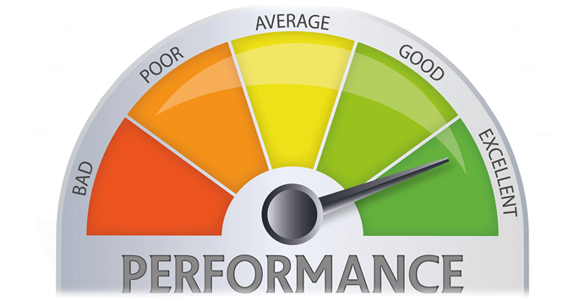
Performance
COMPLETED SP / REAL TOTAL HOURS
21
Notes:
We’ve also updated our metric to measure the performance of our team members in matters of tasks. The new version of the metric uses the current completed story points done by the member in the sprint, and the total amount of hours spent by that member for doing those story points, resulting in a percentage which shows the performance of the team member based on his tasks completed during the week and the hours spent on them.

Slide 19
Contingency Plan
Punishments
+
Team Building
+
Tasks’ Distribution
39
Notes:
Por último, hemos desarrollado un plan de contingencia en caso de haber problemas en el equipo de desarrollo. Dicho plan se basa en el uso de castigos en nuestras sesiones de team-building, apoyándose a su vez en nuestro sistema de recompensas, y una posterior reorganización de las tareas en caso de ser necesario. Todos los posibles problemas, además, serán tratados en reuniones urgentes específicas para ellos.

Slide 20


Features
Transactions
Interactive
Ordinary Use Cases
22
Notes:
We’ve also finished many features of our project, including the basic CRUDS and the creation of interactive exercises proposed in sprint 1, the persistence of those exercises in our database, an update for our welcome page and the style of the whole platform…

Slide 21


Features
Security
Style
Feedback
23
Notes:
The whole license’s system, allowing schools to register in our system choosing the license they want, many other little use cases in our Django Model, the main part of our transaction’s system, some issues related with security y la posibilidad de registrar automáticamente profesores y alumnos en el sistema mediante un archivo csv.

Slide 22

Everyone’s Tasks
EVERYONE
5h 30min
27
Notes:
Talking now about the concrete tasks done by the team, everyone in the sprint has participated in meetings whose objective was to review the presentations of the sprint and see how the project was developing. That resulted in a total of 5 hours and 30 minutes per member.

Slide 23
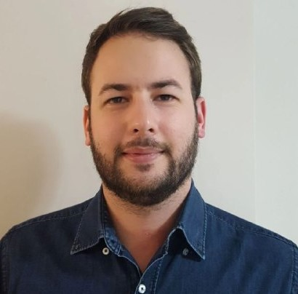

Personal Tasks
Alejandro Román, Project Manager
ESTIMATED
REAL
 | 2 h
 | 1h
29
Notes:
Álvaro Domínguez, our business manager, has been working this sprint creating the two presentations done in it, their respective upgrade reports, the application of the pilot plan…

Slide 24

Personal Tasks
Alejandro Román, Project Manager
ESTIMATED
REAL
 | 22h | 17h
TASKS | 2h | 2h 15min
PROGRESS: 74% PERFORMANCE: 65%
28
Notes:
Now speaking member by member, Alejandro Román, our project manager, has been working this sprint in the tasks’ distribution and in the notebook’s read-only view, solving the problems left by last sprint and correcting its bugs. That resulted in a 74% of the progress of the task and a performance of 65% during this week.

Slide 25


Personal Tasks
Álvaro Domínguez, Business Manager
ESTIMATED
REAL
 | 10 h | 3h 40 min
 | 2h | 10 min
 | 8h | 5h 16 min
29
Notes:
Álvaro Domínguez, our business manager, has been working this sprint creating the two presentations done in it, their respective upgrade reports, the application of the pilot plan…

Slide 26
Personal Tasks
Álvaro Domínguez, Business Manager
ESTIMATED
REAL
WELCOME PAGE | 1 h | 47 min
CONTINGENCY PLAN | 1h | 23 min
PROGRESS: 57% PERFORMANCE: 130%
30
Notes:
The upgrade of our welcome page and the creation of the contingency plan. That resulted in a 57% of the progress of the task and a performance of 130% during this week.

Slide 27
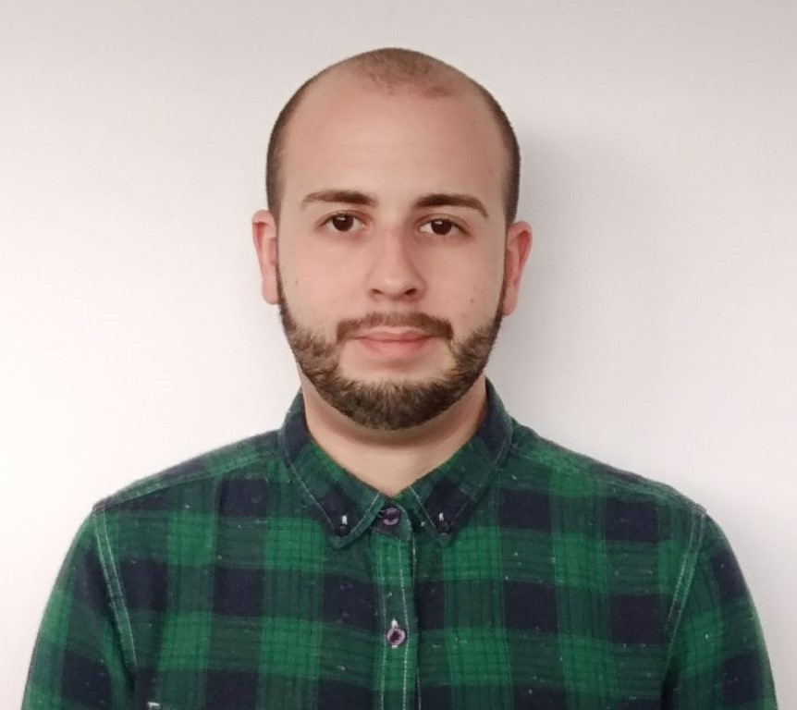

Personal Tasks
Miguel Ángel Baños, Front-End Developer
ESTIMATED
REAL
 | 18h | 20h
 | 8h | 10h
PROGRESS: 96% PERFORMANCE: 86%
31
Notes:
Pasando ahora a nuestros desarrolladores de Front-End, Miguel Ángel Baños ha estado trabajando en la solución de algunas incidencias de seguridad de los ejercicios interactivos, estableciendo un IFrame Sandbox y expresiones regulares en las partes de código editable para evitar que código malicioso acceda al DOM de nuestra página o persista en la base de datos. para evitar. Además, ha trabajado en los bugs aparecidos en el notebook, los problemas que quedan del sprint anterior y la vista de sólo lectura. Ha tenido esta semana un rendimiento del X%, completando un 96% de sus tareas.

Slide 28
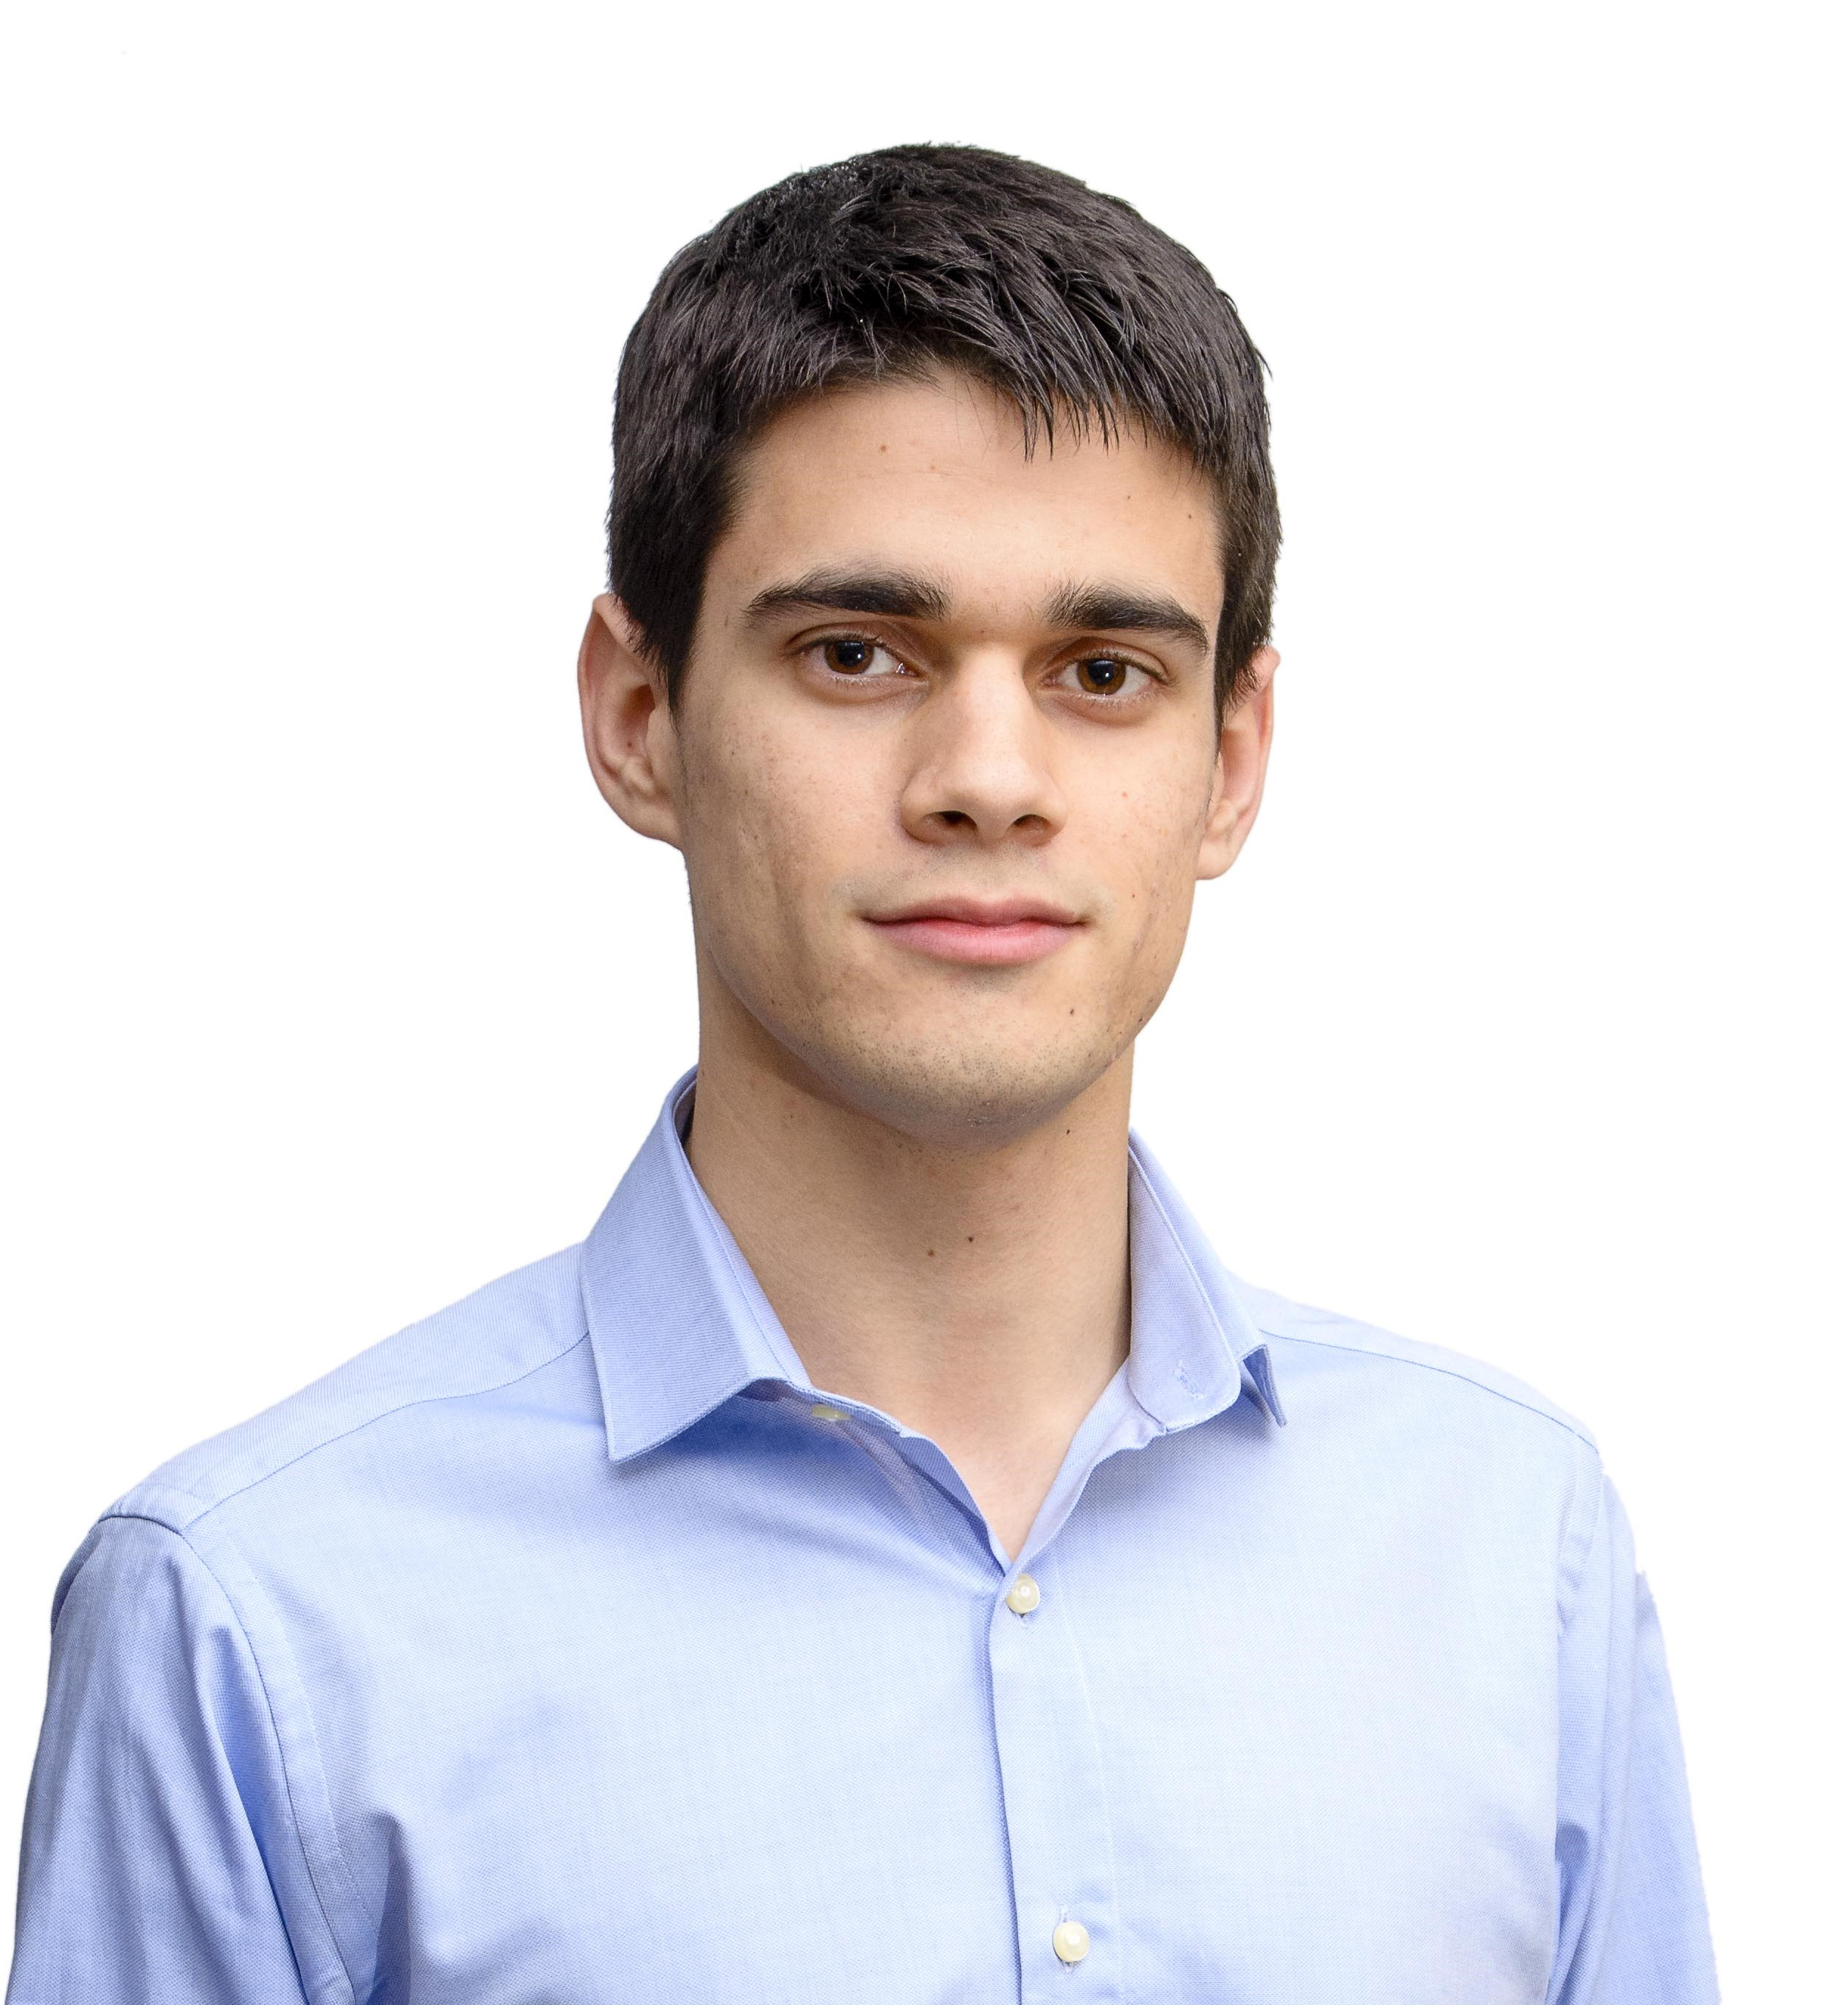
Personal Tasks
Alejandro Garrido, Front-End Developer
ESTIMATED
REAL
 | 21 h | 7h
METRICS | 1h | 30min
32
Notes:
Alejandro Garrido ha estado trabajando en la actualización de la navegabilidad y el estilo de la plataforma, así como en la gestión y actualización de métricas del equipo de trabajo. Ha tenido esta semana un rendimiento del 85%, completando un 45% de sus tareas.

Slide 29
Personal Tasks
Alejandro Garrido, Front-End Developer
ESTIMATED
REAL
BUDGET | 1 h
PROGRESS: 62% PERFORMANCE: 78%
34
Notes:
Y en la posibilidad de subir automáticamente con un excel profesores y alumnos y registrarlos en un centro. Ha tenido esta semana un rendimiento del 78%, completando un 62% de sus tareas.

Slide 30
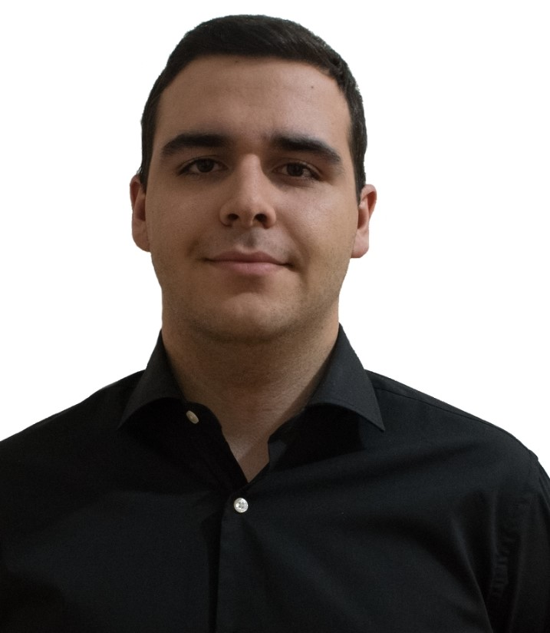
Personal Tasks
Andrés Ferández, Back-End Developer
ESTIMATED
REAL
 | 3 h | 2h 50min
 | 9h | 3h 16min
33
Notes:
Por último respecto a nuestros desarrolladores de Front-End, Andrés Fernández ha estado trabajando en la corrección de bugs en los casos de uso del modelo Django, el tratamiento de incidencias de seguridad en la plataforma…

Slide 31

Personal Tasks
Andrés Ferández, Back-End Developer
ESTIMATED
REAL
 | 9 h | 10h 45min
PROGRESS: 62% PERFORMANCE: 78%
34
Notes:
Y en la posibilidad de subir automáticamente con un excel profesores y alumnos y registrarlos en un centro. Ha tenido esta semana un rendimiento del 78%, completando un 62% de sus tareas.

Slide 32
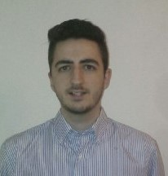

Personal Tasks
Jesús Sosa, Back-End Developer
ESTIMATED
REAL
 | 10h | 6h
 | 10h | 9h
 | 4h | 2h 30min
35
Notes:
Jesús Sosa ha estado trabajando en la elaboración de las demos del sprint, la corrección de bugs en los casos de uso del modelo Django, la solución de incidencias de seguridad…

Slide 33
Personal Tasks
Jesús Sosa, Back-End Developer
ESTIMATED
REAL
INTERACTIVE EXERCISES | 3 h | 2h 32min
PROGRESS: 44% PERFORMANCE: 52%
36
Notes:
Y la terminación de la batería inicial de ejercicios interactivos. Ha tenido esta semana un rendimiento del 52%, completando un 44% de sus tareas.

Slide 34
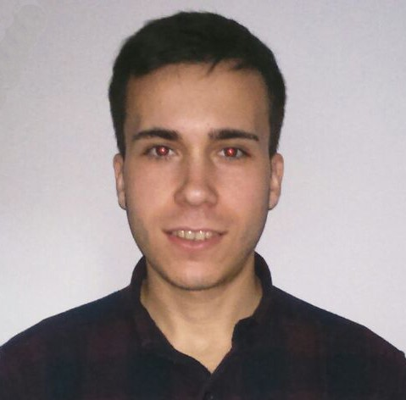
Personal Tasks
Álvaro Sánchez, Back-End Developer
ESTIMATED
REAL
 | 16h | 13h
 | 6h | 8h
37
Notes:
Por último, Álvaro Sánchez ha estado trabajando en el sistema de transacciones y la corrección de bugs en los casos de uso del modelo Django. Ha tenido esta semana un rendimiento del 71%, completando un 75% de sus tareas.

Slide 35
Personal Tasks
Álvaro Sánchez, Back-End Developer
ESTIMATED
REAL
 | 1h
PROGRESS: 62% PERFORMANCE: 78%
34
Notes:
Y en la posibilidad de subir automáticamente con un excel profesores y alumnos y registrarlos en un centro. Ha tenido esta semana un rendimiento del 78%, completando un 62% de sus tareas.

Slide 36
Group’s Hour Deviation
38
Notes:
To see better the big picture behind the hours’ invested by each member, we have this graphic in which we can see the difference between the estimated hours and the real hours invested by each member during this sprint. As we see, the difference has significantly decreased since last time, but still there is work to do if we want to keep these figures.

Slide 37
Deployment & Demo
Deployment URL: www.climbcode.tk
Demo URL:
https://youtu.be/3YsYJetMqHo
26
Notes:
To show how the system works today, we’ve put a link in which everyone can see our project, and also we’ve created a demo, showing our star use case: The creation and buying of an interactive exercise. https://youtu.be/3YsYJetMqHo

Slide 38
Pilot Plan’s Results
Notes:
Now we’ll see the things we’re currently doing in our project.

Slide 39


Pilot Plan
24
Notes:
Finally, we’ve been applying our pilot plan, speeding it up by finishing the meetings with programmers and obtaining their feedback and starting doing meetings with schools, our main source of income and obtaining feedback from them, too. En estas reuniones se les ha mostrado los casos de uso estrella para que diesen su opinión. También se les ha enseñado el sistema de creación de ejercicios interactivos, se les ha pedido sugerencias de mejora y se les ha preguntado sobre los precios de la plataforma.

Slide 40
Results: Feedback
25
Notes:
De este feedback hemos decidido por ahora aplicar los dos más solicitados por los clientes, que consisten en el registro automatizado de alumnos y profesores con un documento csv y el mantenimiento de forma segura de los datos de los alumnos. Respondiendo a nuestra pregunta inicial de si es necesario programar para usar nuestra plataforma, los clientes nos han respondido que no presentan tanto interés en tener en ella ningún mecanismo para aprender o fomentar la programación en el ámbito escolar, ya que prefieren centrarse en los ejercicios interactivos y su uso.

Slide 41


Results: Feedback
DASHBOARD
53
Notes:
Y además seguiremos analizando posible feedback implantable, como la posibilidad de corregir ejercicios interactivos, mostrar un dashboard con toda la actividad de los usuarios a los profesores y los propios alumnos, y la posibilidad de imprimir los ejercicios interactivos en formato PDF. Una vez analizadas las opciones, las que se acepten serán implantadas para el final del sprint.

Slide 42
Results: Figures
10 Users
53
Notes:
Y además seguiremos analizando posible feedback implantable, como la posibilidad de corregir ejercicios interactivos, mostrar un dashboard con toda la actividad de los usuarios a los profesores y los propios alumnos, y la posibilidad de imprimir los ejercicios interactivos en formato PDF. Una vez analizadas las opciones, las que se acepten serán implantadas para el final del sprint.

Slide 43
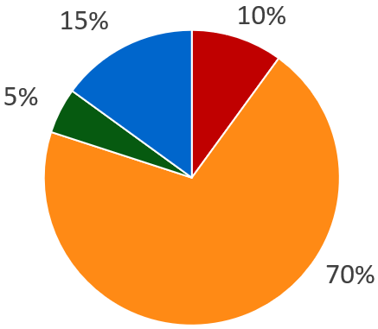
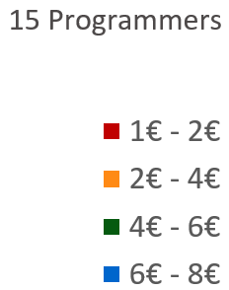
Results: Figures
Exercises’ price (Programmers)
53
Notes:
Y además seguiremos analizando posible feedback implantable, como la posibilidad de corregir ejercicios interactivos, mostrar un dashboard con toda la actividad de los usuarios a los profesores y los propios alumnos, y la posibilidad de imprimir los ejercicios interactivos en formato PDF. Una vez analizadas las opciones, las que se acepten serán implantadas para el final del sprint.

Slide 44
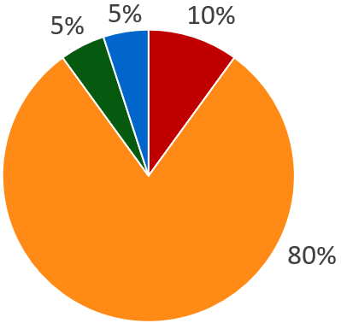
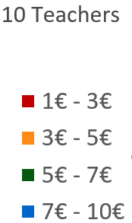
Results: Figures
Exercises’ price (Schools)
53
Notes:
Y además seguiremos analizando posible feedback implantable, como la posibilidad de corregir ejercicios interactivos, mostrar un dashboard con toda la actividad de los usuarios a los profesores y los propios alumnos, y la posibilidad de imprimir los ejercicios interactivos en formato PDF. Una vez analizadas las opciones, las que se acepten serán implantadas para el final del sprint.

Slide 45
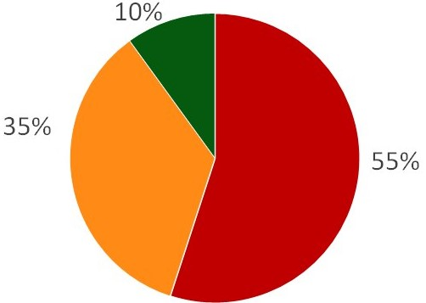
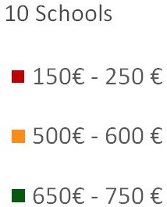
Results: Figures
Licenses’ price (Schools)
53
Notes:
Y además seguiremos analizando posible feedback implantable, como la posibilidad de corregir ejercicios interactivos, mostrar un dashboard con toda la actividad de los usuarios a los profesores y los propios alumnos, y la posibilidad de imprimir los ejercicios interactivos en formato PDF. Una vez analizadas las opciones, las que se acepten serán implantadas para el final del sprint.

Slide 46
Status
Notes:
Finally, we’ll see some conclusions about the current situation of the project.

Slide 47
Current Costs & Time
0%
50%
100%
€16K
900 h
€29K
1120 h
Current: €55%, 80% h
Budgeted: €50%, 50% h
41
Notes:
Currently we’ve spent a total amount of 900 hours and 16k euros, which is a 80 and a 55 percent from the total, and different from the 50 expected this week.

Slide 48
Costs’ Explanation
41
Notes:
Currently we’ve spent a total amount of 900 hours and 16k euros, which is a 80 and a 55 percent from the total, and different from the 50 expected this week.

Slide 49
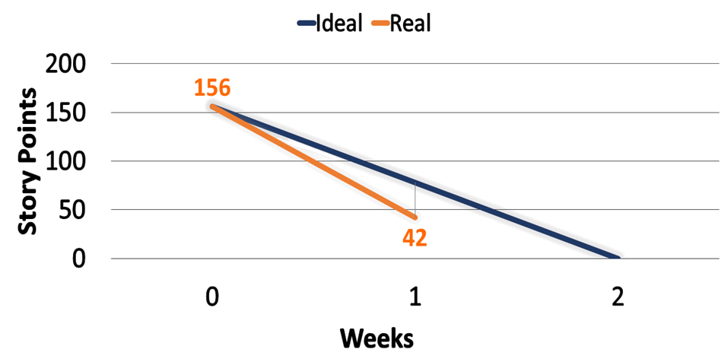
Current Sprint’s SP
42
Notes:
These hours and money investments are visible in these burndown graphics. The first one shows us the amount of Story Points done at this moment of the sprint, comparing it to the ideal development of the sprint itself. As we see, el desarrollo de este sprint va bastante mejor de lo esperado.

Slide 50
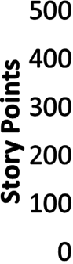
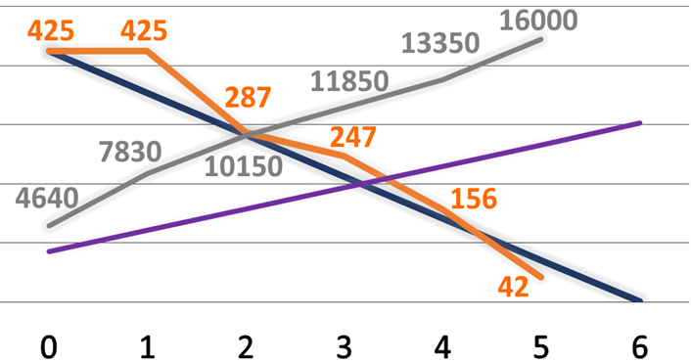
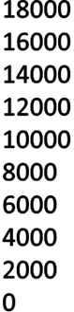

Current Project’s Situation
43
Notes:
The second graphic shows us the Story Points done during the full development of the project, comparing it with the remaining for the whole project and the ideal development of it. As we see, a pesar de que el desarrollo del proyecto va óptimo, los costes están bastante por encima del ideal.

Slide 51

Current Project’s Usage
Current usage: 56%
Evolution: +4 users/week
43
Notes:
The second graphic shows us the Story Points done during the full development of the project, comparing it with the remaining for the whole project and the ideal development of it. As we see, a pesar de que el desarrollo del proyecto va óptimo, los costes están bastante por encima del ideal.

Slide 52
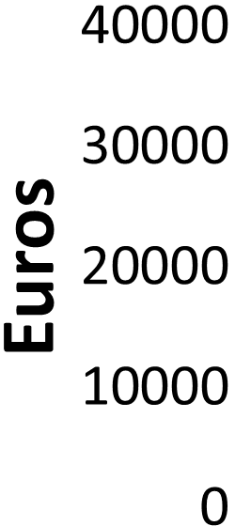
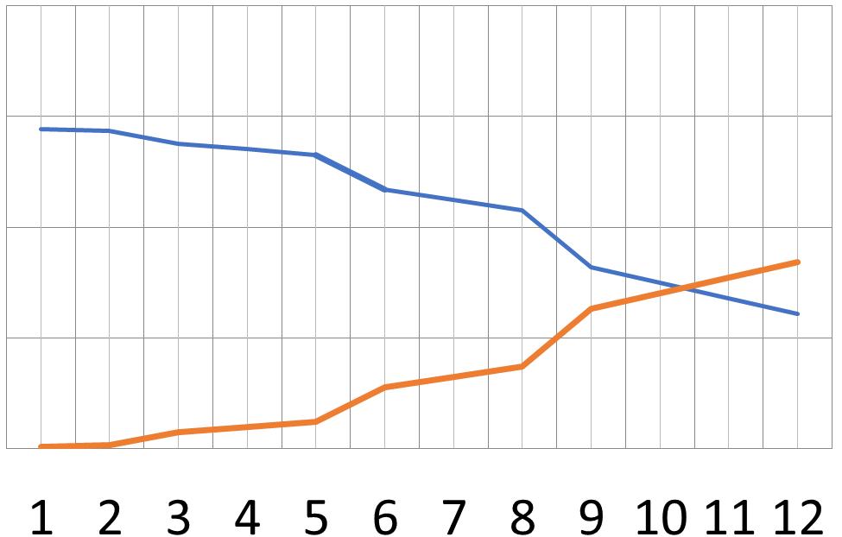



Breaking Point
43
Notes:
The second graphic shows us the Story Points done during the full development of the project, comparing it with the remaining for the whole project and the ideal development of it. As we see, a pesar de que el desarrollo del proyecto va óptimo, los costes están bastante por encima del ideal.

Slide 53

Conclusions
DEVELOPMENT FINISHED
55
Notes:
A pesar de que lo que nos quedan son pinceladas sueltas de diferentes funcionalidades, el conjunto completo aún no está terminado. Sí es cierto que el núcleo principal de la plataforma está operativo, por lo que a pesar de tener trabajo por pulir y hacer, el avance del proyecto resulta positivo gracias a todo el esfuerzo que estamos poniendo el equipo de trabajo, al cual quiero felicitar.
Nos queda aún trabajo por hacer, y nuestra perspectiva es positiva a pesar de los baches que hemos tenido que superar.

Slide 54

THANKS!
You can find me at
alvdomnun@alum.us.es
56
Notes:
And that’s the end of our presentation! Thank you for watching, and if you have any doubt you can contact me at alvdomnun@alum.us.es.

